Slide 1
Filing US Taxes in 2023
Katelynn Minott CPA
Bright!Tax CEO

Slide 2
Today’s Agenda
1
2
3
4
Setting the Foundation
Avoiding Double Taxation
Catching Up
with
Uncle Sam
Answering Your Questions

Slide 3
Setting the Foundation

Slide 4
Every American who meets these minimum income thresholds has to file
The following apply to worldwide income in 2022 (the tax return you’ll file in 2023):
Single
$12,950
Married Filing Jointly
$25,900
Head of Household
$19,400
Married Filing Separately
$12,950
Source: Internal Revenue Source

Slide 5
FBAR Filing Requirements
FBAR, FinCEN Report 114
$10,000 USD equivalent at any time, across all accounts abroad
Accounts Reported:
Checking & Savings
Investments
Mortgage Offset
Life Insurance with Savings
Pension
Signature Authority

Slide 6
Filing Deadlines for Americans Living Outside the U.S.
!
April 17 (normally April 15)
Tax Return Due
FBAR Due
!
June 15
Tax Return Due for Expats
!
Oct 16 (normally Oct 15)
Automatic Return Extension
Extended FBAR Filing
!
Dec 15
Additional (& Final) Expat Extension

Slide 7
Avoiding Double Taxation

Slide 8
But there’s good news!
Most can claim the Foreign Tax Credit or Foreign Earned Income Exclusion
1
2
Foreign
Tax Credit (Form 1116)
Foreign Earned Income Exclusion (Form 2555)
A nonrefundable tax credit for income taxes paid to a foreign government as a result of foreign income tax withholdings.
A tax benefit allowing expats to exclude the first $112,000 of their income. With this form, one can also claim the Foreign Housing Exclusion.

Slide 9
Which one should you choose?
It depends! Each circumstance is unique
Foreign Tax Credit
Requirements
Only works if you’ve paid foreign tax
Can only be applied to foreign taxes paid on foreign source income.
Foreign Earned Income Exclusion
Requirements
Must meet either the Physical Presence Test or Bona Fide Residence Test
Can only be applied to earned income (i.e. salaries, self-employment, wages).
Notes:
Physical Presence Test:
330 days abroad during any 365-day period
Bona Fide Residence Test:
Reside abroad for at least one full calendar year
Pay taxes abroad
Permanent residence visa abroad
Family abroad with you

Slide 10
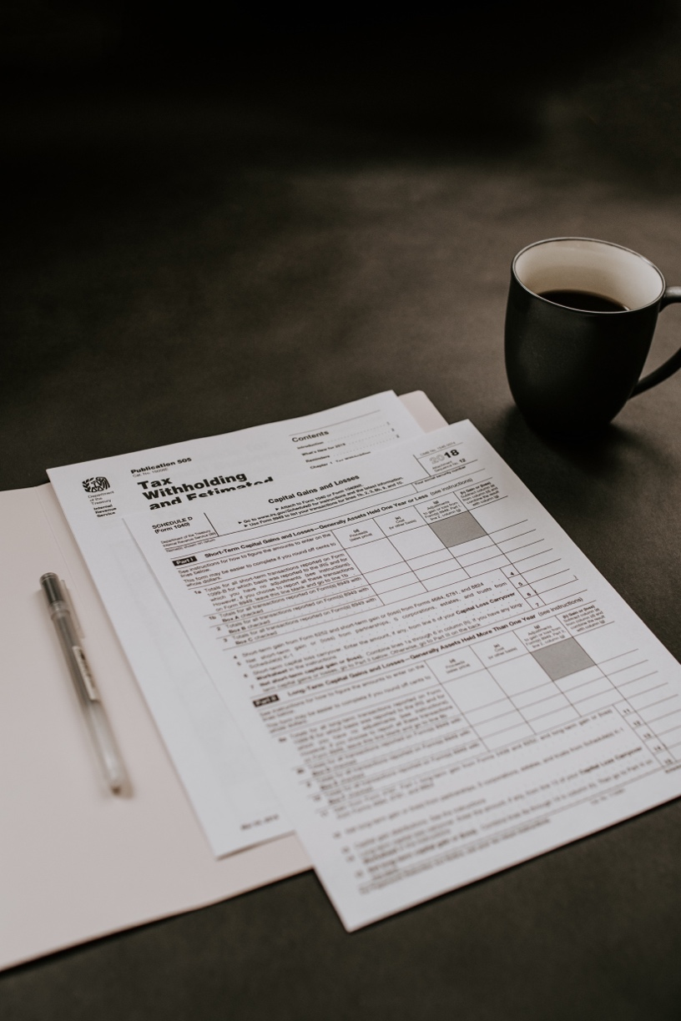
Unfortunately…
No Totalization Agreement exists with Panama.
In other words, employees must pay into the social security system! And you may be required to pay into the US system as well.
(Read: the process is tricky! Contact a tax professional to help you understand the financial implications and requirements.)

Slide 11
Child Tax Credits
(Children can be less taxing!)
Child Tax Credit
Generally used to reduce your tax bill (nonrefundable)
Refundable Child Tax Credit
$1,500 refund for those abroad*
Advance Child Tax Credit
For families in the US for more than 6 months
*Cannot be used with Form 2555 (FEIE)

Slide 12
Reduce your U.S. tax bill by avoiding penalties altogether!
File on time, pay on time
International Business Disclosures
Form 5471 - Foreign Corporate Disclosure
Form 8938 - Statement of Foreign Financial Assets
Form 8865 - Foreign Partnership Disclosure
Form 8621 - Passive Foreign Investment Companies
FBAR
FinCen Form 114
No Tax, big penalties!

Slide 13
Catching Up with Uncle Sam

Slide 14
The Streamlined Procedure is a penalty free way of getting compliant!
File 3 past due tax returns and file 6 past due FBARs
Requires absence from the US for 330 days during one of the three delinquent tax return years
Certify not filing was a result of non-willful conduct with Form 14653
The IRS has not contacted you first – Beat them to it!

Slide 15
Have you claimed your COVID-19 Stimulus Payments?
How is it paid & how much is it?
Round 1 (2020 tax return): $1,200 per individual taxpayer + $500 per qualifying child
Round 2 (2020 tax return): $600 per individual taxpayer + $600 per qualifying child
Round 3 (2021 tax return): $1,400 per individual taxpayer + $1,400 per dependent
How do I get it?
American taxpayers with a valid SSN
Automatic as a result of tax return filing - file if haven’t already
Recovery Rebate Credit on 2020 & 2021 tax returns

Slide 16
Passing the mic to you!
Do you have any questions?

Slide 17
Thank you for your time today!
Katelynn Minott CPA
Bright!Tax CEO

